Slide 1
Safety and Health Training
Tiffany Rice, CSP
WVU Safety and Health Extension
Tiffany.Rice@mail.wvu.edu

Slide 2
Elements of Safety & Health Programs
Source: OSHA

Slide 3
Elements of Safety & Health Programs
Education and Training
Action Item 1: Provide program awareness training
How to accomplish it:
Provide training to all managers, supervisors and workers as well as contractors and temporary workers on: safety policies and procedures, program functions, emergencies, injury illness reporting, and their rights under the OSH Act
Ensure the training is provided in a language and literacy level that all workers can understand
Notes:
Ask the class; What types of training have you received as a worker, and do you know what types of training are required by OSHA?

Slide 4
Elements of Safety & Health Programs
Education and Training
Action Item 2: Train workers on specific roles and responsibilities in the safety and health program
How to accomplish it:
Instruct workers with specific roles within the safety and health program on how they should carry out those responsibilities
Provide opportunities for workers to ask questions and offer feedback during training

Slide 5
Elements of Safety & Health Programs
Education and Training
Action Item 3: Train workers on hazard identification and controls
How to accomplish it:
Train managers and workers on techniques for identifying hazards; such as job hazard analysis
Have workers demonstrate they can recognize hazards and understand why controls are in place
Provide training on new tasks and new assignments
Provide training where required by specific OSHA standards such as; hazard communication and lockout/tagout

Slide 7
OSHA Publication 2254

Slide 8
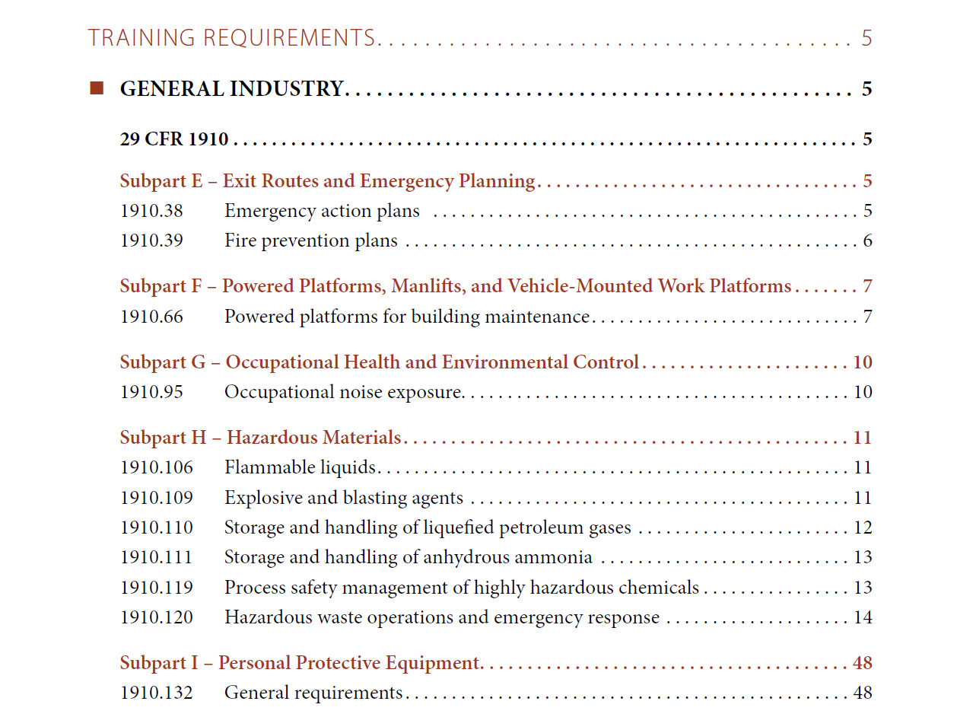
TESTING ONE

Slide 9
Elements of Safety & Health Programs
Multi-Employer Worksites
Action Item 5: Education and Training
How to accomplish it:
The host employer and contractor identify any qualifications and certifications required by the workers
Temporary and contract workers also receive appropriate hazard and standard specific training

Slide 10
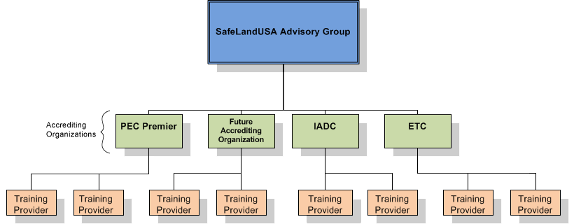
Accrediting Organizations
WVU
Approved Instructors

Slide 11
Module 1
Introduction

Slide 12
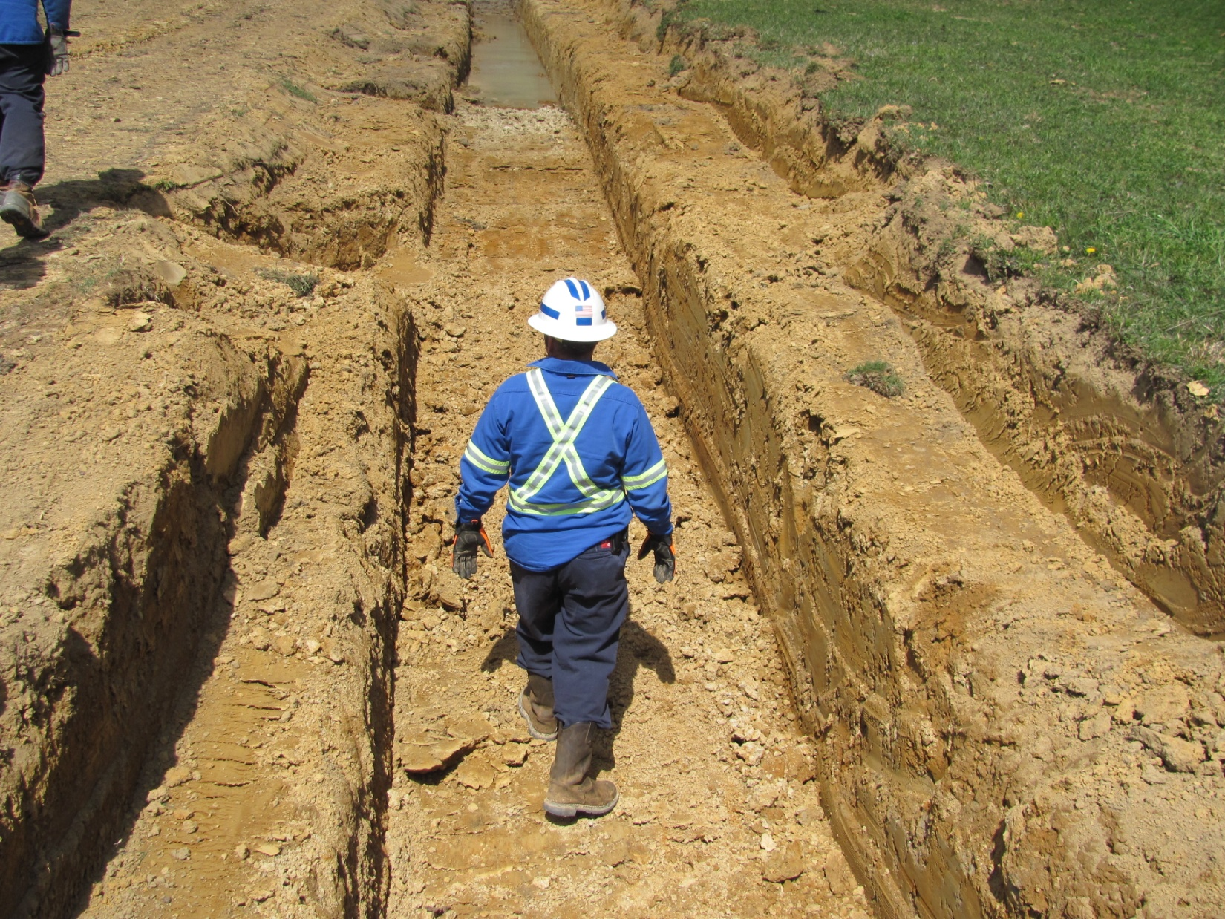
this pipeline trench is benched to prevent cave-ins

Slide 13
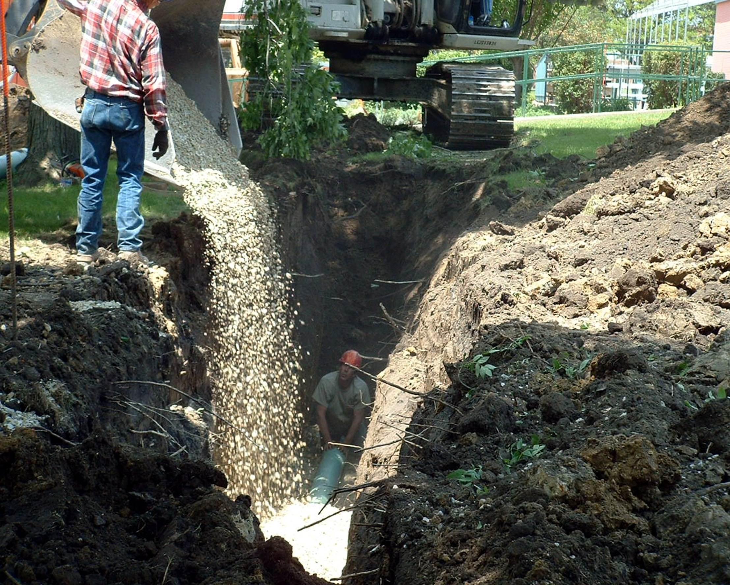
the worker in this trench has no safe means of exit
see page 153
Corrective Action: for trenches 4’ deep or greater, install a ramp, ladder, or stairs no less than every 25’ from a worker in the trench
Notes:
This photograph shows a worker with no means of getting out of the trench in a hurry. OSHA would cite the employer for no ladder in the excavation for access/egress. [1926.651(c)(2)]

Slide 14
HSE Professional Training
O&G Industry Specific Courses
OSHA 5810
IADC RigPass (AWARE)
H2S Training Provider
Instructor Course
Job Safety Analysis

Slide 15
HSE Professional Training
Courses
CSP Prep Course
OSHA 511 * 510 (Standards)
7000 series & specific topic
OSHA 501 * 500 (Trainers)
OSHA 503 * 502 (Updates)
Allows to you become a OSHA 10 & 30 hour instructor
90 day grace period eliminated

Slide 16
Tiffany Rice, CSP
Adjunct Instructor
WVU Safety and Health Extension
Tiffany.Rice@mail.wvu.edu

